Slide 1

Heredity and Evolution
Acquired And Inherited Traits

Slide 2


Lets discuss about Acquired and Inherited Traits

Slide 3

Acquired and Inherited Traits
There are two types of cells in any organism
Germ cells
Somatic cells
Germ cells are the cells of reproductive tissue which pass the changes from one generation to another.
Somatic cells are the cells of body tissue which does not pass the changes from one generation to another.
Such traits which can not be passed from one generation to another are called as Acquired traits
Such traits which can be passed from one generation to another are called as Inherited traits

Slide 4
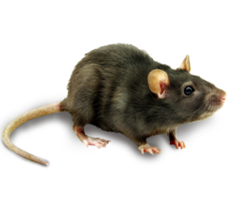

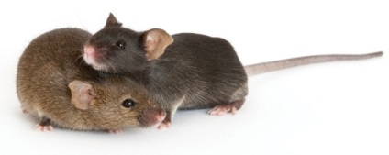



Acquired and Inherited Traits
There are two types of cells in any organism
Inherited Traits
Germ cells
Somatic cells
Acquired Traits
Lets take group of mice with tail
If we breed a group of mice with tail
For example
All offspring's will have tail

Slide 5
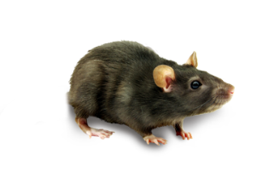

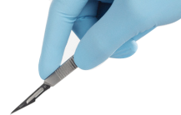



Acquired and Inherited Traits
There are two types of cells in any organism
Inherited Traits
Germ cells
Somatic cells
Acquired Traits
For example
If tails of mice are removed by surgery
If we breed these tailless mice
All offsprings will have tail
All offsprings will have tail as tail don’t have germ cell and removal of tail can’t change the genes of germ cells
Such characters which are not inherited are called as Acquired Characters

Slide 6
Thank You

